Slide 1

Customer Segmentation of Online Retail Customers
Gillian Tatreau
Department of Data Science, Bellevue University
DSC680: Applied Data Science
Amirfarrokh Iranitalab
4 February 2024

Slide 2
Business Problem
To increase profit, must understand customer base
Customer segmentation divides customers by shared characteristics

Slide 3
Data Explanation
Data found on Kaggle
Data preparation:
Convert InvoiceDate to datetime
Remove NA values
Outlier assessment via boxplots and outlier removal

Slide 4
Methods
EDA
K-means clustering
Word clouds

Slide 5
Analysis
4,329 unique customers
Average of 92 transactions per customer
37 unique entries for the Country variable
United Kingdom has largest number of transactions and number of unique customers
8 countries that have higher average transactions per customer than the overall average- France, Germany, Netherlands, Australia, Norway, EIRE, Iceland, and Singapore.
Singapore possibility of growing market

Slide 6
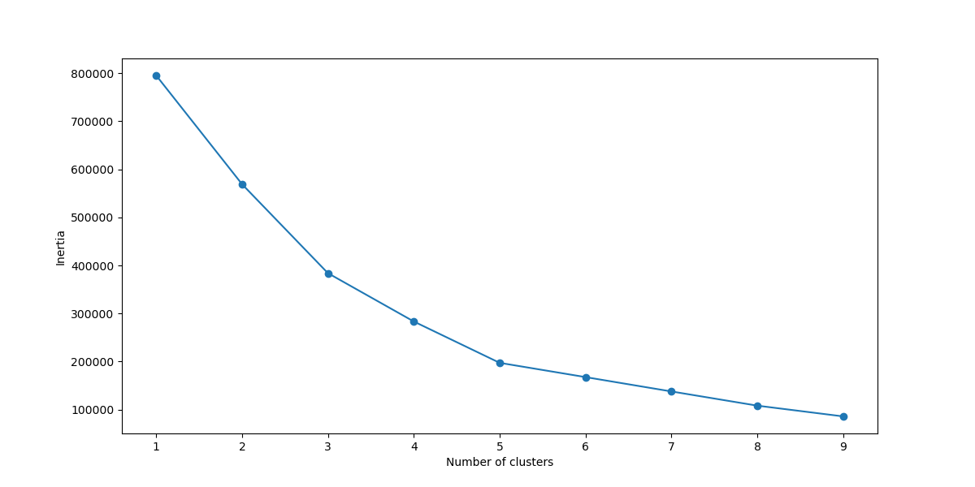
Transaction Segmentation

Slide 7
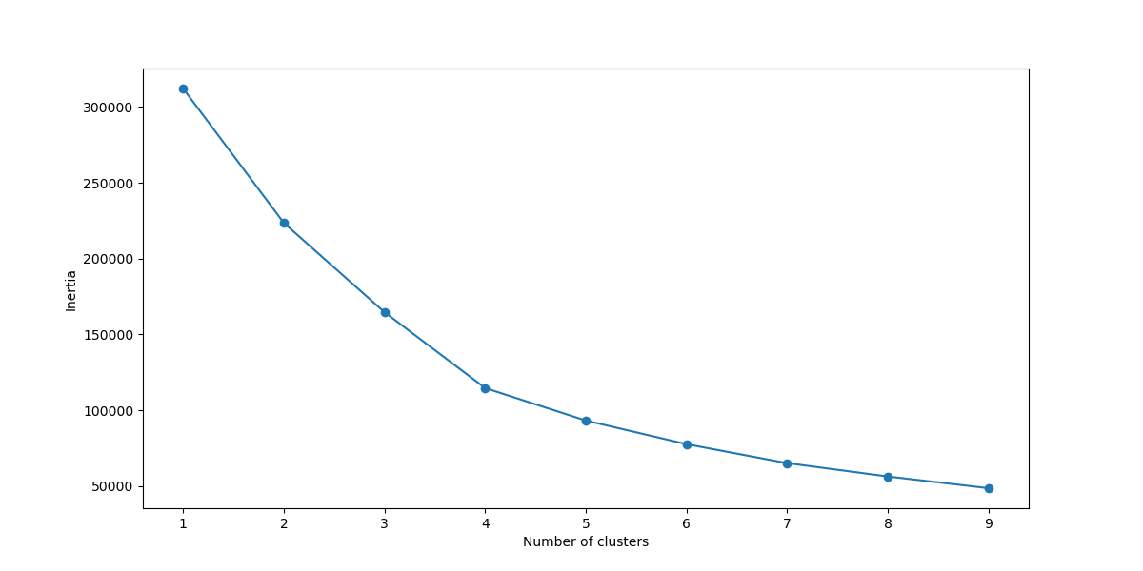
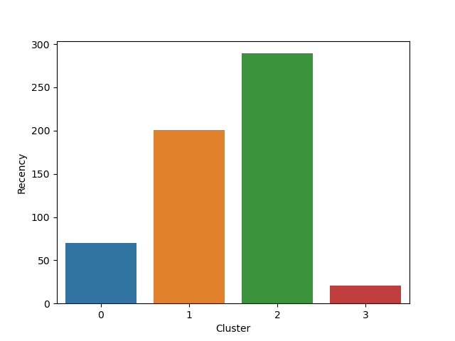
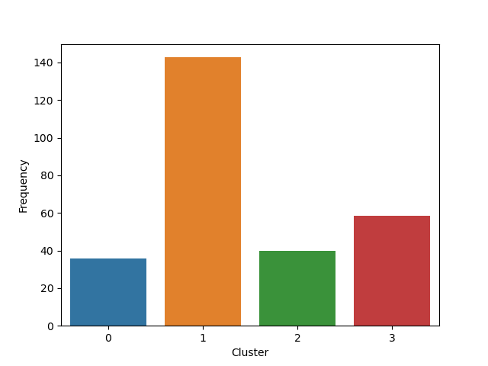
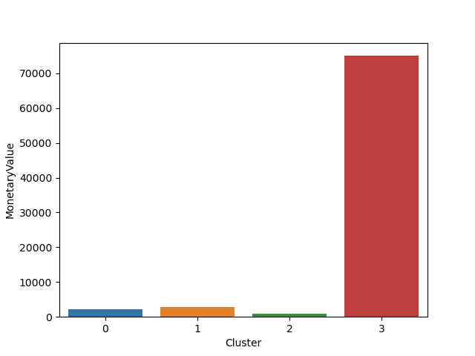
Customer segmentation
Recency, frequency, monetary value
Cluster 0- Occasional Browsers
Cluster 1- Regulars
Cluster 2- New Customers
Cluster 3- Big Spenders

Slide 8
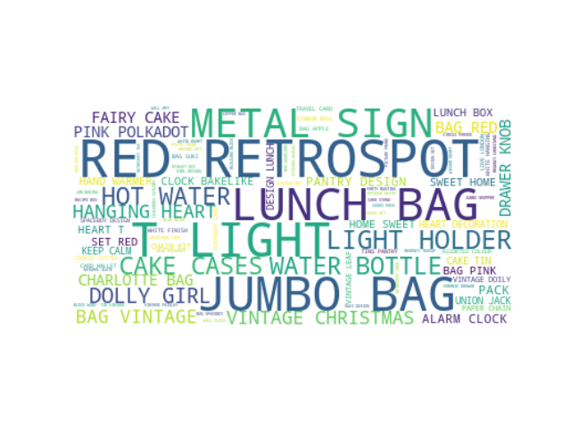
Common Words in Product Descriptions

Slide 9
Recommendations/Future Uses
Initial word frequency analysis, via word clouds, used as guide for future recommender systems
Special offers and communications tailored to each cluster

Slide 10
Conclusion
4 customer segments
Primary assumption: all values for UnitPrice conveyed in one currency value for all transactions
Ethical Considerations
Consumer privacy, transparency, and fairness

Slide 11
References
RFM analysis for Customer Segmentation. CleverTap. (2023, November 29). https://clevertap.com/blog/rfm-analysis/
Szafraniec, M. (2017, June 22). Online retail invoices dataset. data.world. https://data.world/mszafraniec/online-retail-invoices-dataset

